Slide 1
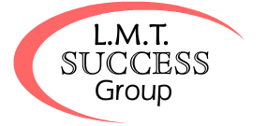
Providing Continuing Education Seminars to Massage Therapists for over 25 years.
Course Catalog 2015-2016

Slide 2
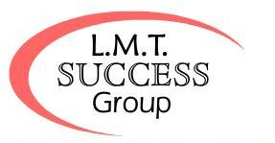
LMT Success Group 2501 W. Hillsboro Blvd., Suite 102 & 102 Deerfield Beach, FL 33442 #800-201-2247 - #954-596-1170 www.lmtsuccessgroup.com
NCBTMB#45001-05 – Nationally Approved for Massage Therapy Continuing Education. The contents of this catalog are presented as an accurate description of the course content. Contents of these courses and this catalog are subject to update and change. Catalog last updated May 2015.

Slide 3
TABLE OF CONTENTS:
About Us 1
Our Credentials 2
Our Policies 3
Our Teachers 4
Course Locations 5
Our Programs 6
Medical Massage Practitioner Certification 7
Testimonials/Are You Ready to Be An MMP? 8
Options for Earning Your MMP 9
Class Descriptions
Medical Massage Certification
Professional Level 10
Master’s Level 11
Medical and Spa Based Courses
Advanced Medical Massage 12
Advanced Sports Massage 12
Arthrossage 12

Slide 4
Class Descriptions
Medical and Spa Based Courses
Lymphatic Drainage 13
Lypossage 13
Flexibility Coach 14
Massage Cupping 14
Thai Yoga Massage 14
WorkSmart Business Classes
Make Money with Chair Massage 15
How to Throw a Massage Party 15
LMT Tax Workshop 16
Marketing Massage 16
Tax & Marketing Series 16
Education Vacation Cruises 17
Adventure Learning in Costa Rica 18
Las Vegas Success School 19
Tools of the Trade
Professional Liability Insurance 20
Massage Office Management Software 21
DVD’s and Books 22
Modalities 23

Slide 5
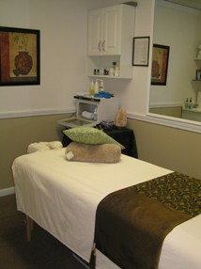
About Us
Did you know that we are massage therapists too? We know what it takes to run a successful massage practice. We can help you to do the same.
Our company was founded in 1986 by massage therapists with the mission of teaching business skills to help other therapists achieve success in their massage practices.
Following the trends in the market, our course schedule grew to include medical massage and spa-related courses.
We were the first massage therapy CE provider to offer Seminars at Sea and we have expanded our Adventure Learning opportunities to include Costa Rica and Las Vegas Success School. Make plans to join us on an education vacation.

Slide 6
Our Credentials
Most states require Massage Therapy Continuing Education providers to be NCBTMB approved. We are approved by the NCBTMB, Provider #450001-05, to provide continuing education to massage therapists on a national level.
There a handful of states that have different requirements. We are have NY sponsorship through the NCBTMB for the following classes: Day of the Back; Day of the Neck; Posture & Pain, Upper Extremity, Lower Extremity; Lymphatic Drainage and Making Money with Chair Massage.
For the State of Mississippi, we are certified to offer Day of the Back; Day of the Neck and Lymphatic Drainage.
We are an approved provider for all classes in the states of Florida and Texas.
If you have any questions regarding CE approval for your state,
please check with your state or call us at #800-201-2247.

Slide 7
Our Policies
Minimums We must reach a minimum number of attendees in order for us to be able to go forward with any class. You will know that we have reached our minimum when you receive a confirmation letter in the mail with a map to the location of the class and a letter indicating what supplies should be brought to the class. We suggest that you wait to receive your confirmation letter before scheduling travel plans or making hotel reservations. We accept no responsibility for fees associated with a class cancellation aside from the class tuition.
Cancellation Policy For Classes: If it is necessary for us to cancel a class, you can chose to receive a refund in the same manner as your payment, you may take a class credit or often times we can switch to the same class at a different location. If it is necessary for you to cancel a class, if you cancel more than thirty days prior to the seminar, you can receive a refund or a credit. If you cancel thirty days or less prior to the seminar, all amounts paid are credited towards a future class. As of 1/1/14, all credits expire on or before 1/1/15. For Cruises: All classes are included with the pricing of the cruise. Any cancellation clause is conditioned by your cruise reservations. For Costa Rica: A minimum deposit of $350 per person must be made to hold your reservation. 50% of the total due will be billed to your credit card on file ninety days prior to the trip. The total balance is due and will be billed to your credit card on file thirty days before the trip. If you need to cancel this more than ninety days prior to the trip, your deposit is completely refundable. After this time, you will receive a credit towards a future trip or classes. As of 1/1/14, all credits expire on or before 1/1/15.
Class Review Policy After you have taken a class, you may review the class for no charge for up to a year from the date in which you first took the class. You may take the class for half-price for up to two years. You will need to bring your original course materials with you to class and you will not receive additional continuing education credits for a review.
Class Locations From time to time it is necessary to change a class location. We will provide you with as much advance notice as possible and the new location will almost always be very close to the location originally scheduled for the class to be held.
Instructors We are unable to guarantee that a particular teacher will teach a particular class. In most instances, the instructor scheduled to cover a class will do so, however scheduling conflicts may occur. We reserve the right to substitute an alternate teacher to cover a class. All of our instructors are skilled, highly trained professionals in our industry and duly authorized as continuing education providers. Most of our instructors are independent contractors responsible for their own class content and administration.

Slide 8
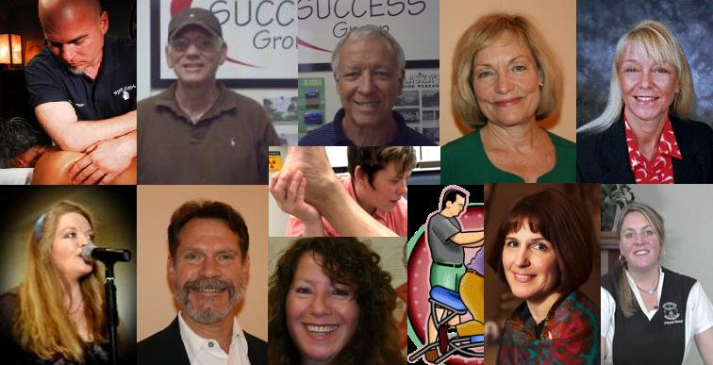
Our Teachers
We have chosen some of the finest massage educators in the business to provide continuing education to you.
All of our teachers are licensed, certified or otherwise duly credentialed to provide continuing education to massage therapists.
All of our teachers are either seasoned therapists themselves or are chiropractic physicians. All maintain or oversee a regular massage practice.

Slide 9
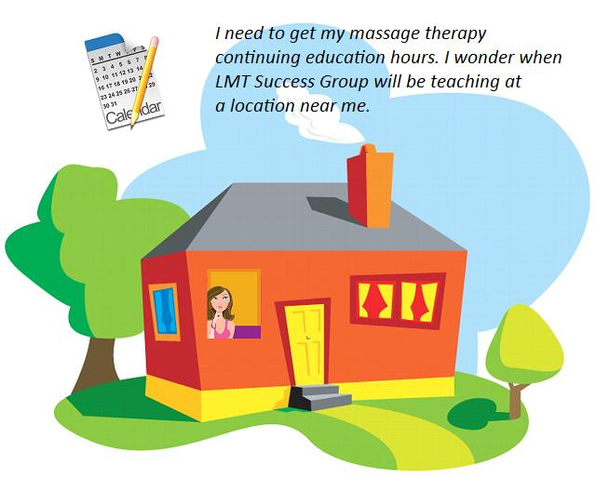
Course Locations
We teach a schedule of classes in many major cities across the United States. We also teach on cruises to various exciting ports of call and at several locations in Costa Rica.
Our schedule is updated many times throughout the course of the year. If we are not currently offering classes in a location near you, we may be soon.
When will there be a class near me?
Check our website to view the current seminar schedule. We will also give you an idea as to when our schedule will again be updated and the region of the country in which those classes will take place.
Join our email list. This is the best way to remain up to date as to future class offerings.
Notifications of schedule updates are posted on Facebook. Like us and feel free to post your questions and comments.

Slide 10
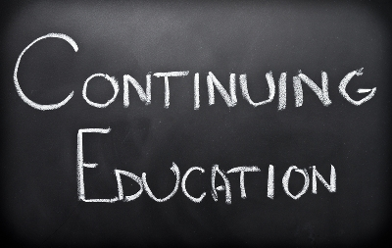
Our Programs
Medical Massage Practitioner Certification
Our Medical Massage Practitioner Certification program is one of the largest in the country. Medical Massage is a growing trend and we are pleased to offer this sought after certification.
Spa and Medi-Spa Based Classes
Whether you work in a spa, a medical office or have your own private practice, the skills and protocols that you will learn in these classes are sure to boost your skills and enhance your business.
WorkSmart Business Series
Our company was founded with the intention of helping skilled therapists make better business decisions. We are still helping therapists to build lucrative practices.
Adventure Learning & Education Vacations
Why not have the time of your life while learning skills to enhance your career? Take a vacation and receive an education. Whether you want to take a cruise, relax at a resort in the mountains or on a white sand beach or live it up in Las Vegas, we have education vacation for you!

Slide 11
Medical Massage Practitioner Certification
A Medical Massage Practitioner Certification will enable you to have a lucrative career that you are proud of.
You can earn your certification by successfully completing six courses.
TO DO:
Earn more money.
Receive respect in the field of massage therapy.
Better serve my clients.
Medical Massage Practitioner Certification
Professional Level Series
Insurance Billing
Day of the Back
Day of the Neck
Master’s Level Series
Posture and Pain
Upper Extremity
Lower Extremity
The classes can be taken in any order and at any location. No testing is required. This certification is a sought-after credential but does not supersede the laws of your state.

Slide 12
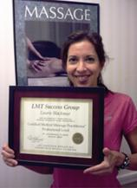
Are you ready to be an MMP?
See what other students are saying about this certification:
This information and protocol is exactly what I have been looking for. Not only does this class provide all the techniques I have wanted to be able to offer medical massage, it has educated me in the ways to set up the business side of my practice. I easily attained my NPI number and feel like I am ready to hit the ground running toward networking with doctors and other medical professionals. Outstanding! It has given me the knowledge to work smarter, not harder. Rachel T., Paso Robles, CA
This class was the best class in my entire 16 years of working in the field of massage therapy, the techniques are very well planned out, easy to understand (educators are wonderful) and the patients just love it, they get off the massage table without pain. Thank you LMT Success Group. A class you must take! Diane J. B., PhD., Hoffman Estates, IL
I have seen a significant increase in clientele since I have received my Medical Massage Practitioner certification. I now network with orthopedic doctors, also chiropractors and physical therapists. The benefits have been exceptional, with amazing health improvements in my clients and additional referrals from these healthcare professionals. Carolyn T., San Antonio, TX
This MMP Certification is wonderful. I am amazed at the referrals received this past year from orthopedic and work comp physicians, chiropractors and physical therapists. Steve Matthews, RMT, MMP
View additional success stories and video clips about this program.

Slide 13
Options for earning your MMP
Take the entire certification.
BEST VALUE
Enroll in the entire Medical Massage Practitioner Certification. You can take all six classes over the course of a week at one of our Adventure Learning opportunities, or over the course of two weekends on our national schedule.
Take the Professional Level Series or the Master’s Level Series and then at your next opportunity, enroll in the other. Each series consists of three classes and is offered both via Education Vacation options as well as over a weekend on a national level.
Take each of the following six classes individually:
Enroll in a series of classes.
GREAT VALUE
Take the classes individually.
VALUABLE
Professional Level Series
Insurance Billing
Day of the Back
Day of the Neck
Master’s Level Series
Posture and Pain
Upper Extremity
Lower Extremity

Slide 14
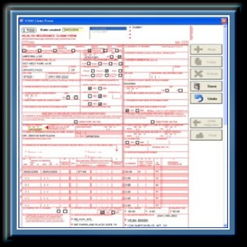
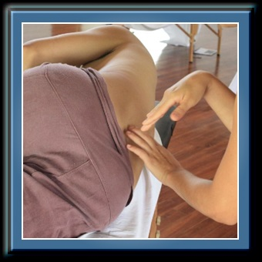
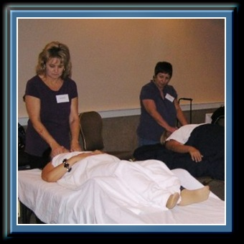
MMP Class Descriptions (Professional Level Series)
Insurance Billing – Learn proven strategies for dealing with personal injury, worker's comp, PIP and private insurance. Get paid quickly and in full. Receive unlimited consultation with any of your claims for an entire year.
Day of the Back - Learn neuromuscular and myofascial techniques to effectively assess and treat lumbago, pelvic tilt, post-op back surgery, sciatica and more.
Day of the Neck – Learn neuromuscular and myofascial techniques to effectively assess and treat whiplash, torticollis, cervical strain, ROM limitations and more.

Slide 15
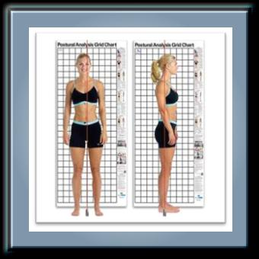
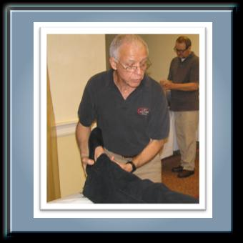
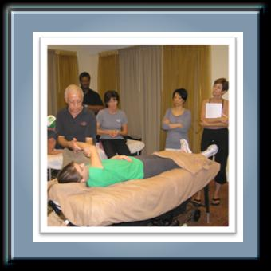
MMP Class Descriptions (Master’s Level Series)
Posture & Pain – Learn about postural distortions, how & why massage therapy works, perform body reading and learn to evaluate misalignments.
Lower Extremity - Learn specific techniques to correct postural misalignments of the lower extremity including shin splints, Chondro-malacia, Plantar Fascitis, and more.
Upper Extremity - Learn specific techniques to correct postural misalignments of the upper extremity including frozen shoulder, rotator cuff strain, tennis elbow and more.

Slide 16
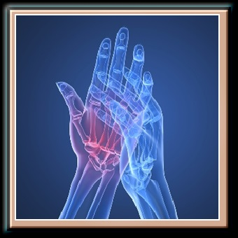
Medi-Spa & Spa-Based Courses
Advanced Medical Massage – Learn advanced muscle testing techniques and corrective protocols to get results with minimal strain on the therapist. Learn medical massage practice building for referrals and repeat business.
Advanced Sports Massage – Course includes A&P and Kinesiology review,
effects of sports massage on athletes,
Stretching, MET, PNF, analysis of postural deviations and pain patterns, and general acute injury evaluation.
Arthrossage - Learn about the autoimmune disease process and how to apply myofascial release techniques, trigger point work and other manual therapies that are appropriate for clients/patients with arthritis and other rheumatic conditions.

Slide 17
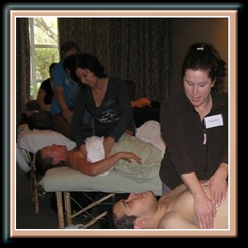
Medi-Spa & Spa-Based Courses
Lymphatic Drainage – This is a succinct and affordable 2-day certification program that will give you the knowledge and ability to immediately incorporate manual lymphatic drainage into your practice. This class is geared specifically to the massage professional and deals strictly with manual lymphatic drainage. The full body protocols can be used for specialty lymphatic drainage massage or can be incorporated into your regular practice.
Lypossage is a non-surgical, manual body contouring technique with proven results. Learn a blend of massage techniques including deep tissue and deep lymphatic drainage that will work to decongest tissue by cleansing stalled lymphatic fluid and break up the adhesions that contribute to the uneven dimpling of the skin. Firm muscles and lift sagging tissue.

Slide 18
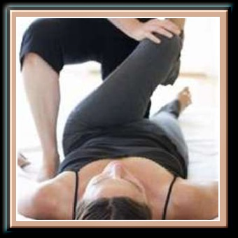
Medi-Spa & Spa-Based Courses
Flexibility Coach - In this certificate program you will learn to integrate PNF, Muscle Energy and Active Isolated Stretching and basic yoga postures into your sessions, adding another layer of healing to your practice, setting you apart from other therapists.
Massage Cupping - Learn to use suction created by the cups to provide a negative pressure, allowing you to work much deeper with no client discomfort and no strain on your body. In this dynamic course you will learn a full body lymphatic drainage treatment using the cups.
Thai Yoga Massage – Learn a 90-minute full body traditional Thai Massage Protocol or learn a Table Thai routine. This may be the most effective bodywork that you ever experience.

Slide 19
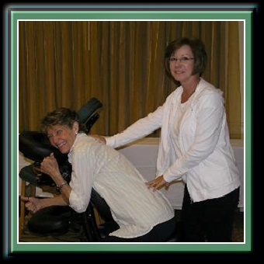
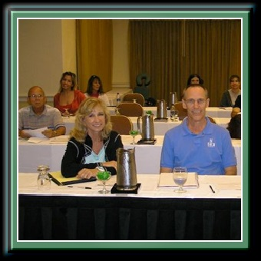
WorkSmart Business Classes
Make Money with Chair Massage - In this dynamic one day class, we will teach you a simple, effective, almost effortless routine which will allow you to immediately and consistently make money with your massage chair. Learn the "secrets" to success at trade shows and festivals including how to earn $1,000+ in one weekend. Get companies, not employees, to pay for your services. Multiply yourself by easily and legally subcontracting your work and much more.
How to Throw a Massage Party - Earn one week's income in one night's work. You never knew massage could be so much fun! Join us as we tell you about the most exciting and fun marketing program that exists. "Massage Parties" are home demonstrations that are specially designed to build your massage business fast and for big profits!

Slide 20
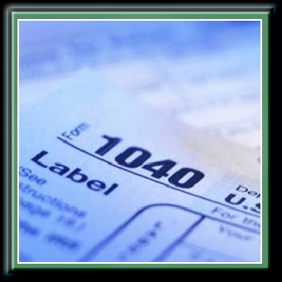
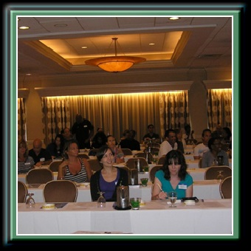
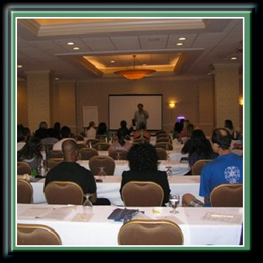
WorkSmart Business Classes
LMT Tax Workshop - In this fast paced seminar, we take you step by step through your Schedule C tax return, then show you how to take travel deductions, write off home office and auto expenses and claim deductions on things you do anyway. Minimizing your taxes is not just good business, it is good common sense!
Marketing Massage - This is the ultimate practice building seminar! Learn hundreds of market tested techniques to get attract and keep massage clients. Learn low cost or no cost methods to get all of the massage business that you will ever need.
Tax and Marketing Series – This series of seminars includes both the LMT Tax Workshop and the Marketing Massage class, mentioned above.

Slide 21
Costa Rica Adventure Learning
Pura Vida Spa – Spend 8-days and 7-nights at this internationally acclaimed yoga resort nestled in the mountains of Costa Rica. You will enjoy exotic adventures, meet new friends and learn from some of the most highly regarded massage therapy teachers in the world. This really is the trip of a lifetime.
Blue Osa Resort – Visit this eco-resort on the beaches of Costa Rica. You can select this as an add on to the Pura Vida trip (5-day, 4-night) or as a stand alone adventure (7-day, 6-night.) Classes complement the curriculum offered at Pura Vida.
Iguana Lodge – If you are looking for a fabulous jungle beach eco-adventure, this is the place to be. You can select this as an add on to the Pura Vida trip (5-day, 4-night) or as a stand alone adventure (7-day, 6-night.) Classes complement the curriculum offered at Pura Vida.
VIEW all current Costa Rica Adventure Learning opportunities.

Slide 22
Education Vacation Cruises
Not only can you advance your massage therapy skills and learn to build a lucrative practice, you can also have the time of your life while you are earning your continuing education credits.
We offer several opportunities throughout the course of a year for you to earn your CE's while at the same time enjoying an education vacation. Classes are only scheduled on sea days so that you will have plenty of opportunity to enjoy exotic locales, go on exciting adventures or just chill out and relax.
Since we have such a high rate of frequent cruisers we do change our course offerings and visit a variety of Ports of Call. The only question is, where do you want to spend your education vacation this year?
VIEW all current Education Vacation Cruise opportunities.

Slide 23
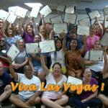
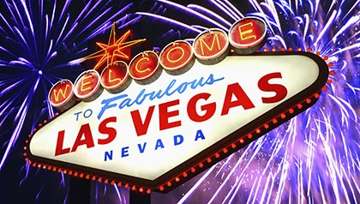
Las Vegas Success School
This is an exceptional educational event that we offer twice a year. You will have the opportunity to take a number of our most popular course offerings taught by our most sought after instructors, over the span of a week.
When you are not in class, there are plenty of extracurricular events for you to take part in, you can enjoy some of the best dining experiences in the world or you can unwind an relax. Our room block offers exceptional pricing on your hotel room making this not only a fantastic vacation but also a great value. Everybody loves Las Vegas Success School!
You know you want to go!
VIEW our current Las Vegas Success School event.

Slide 24
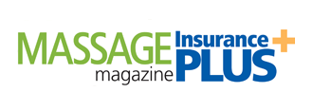
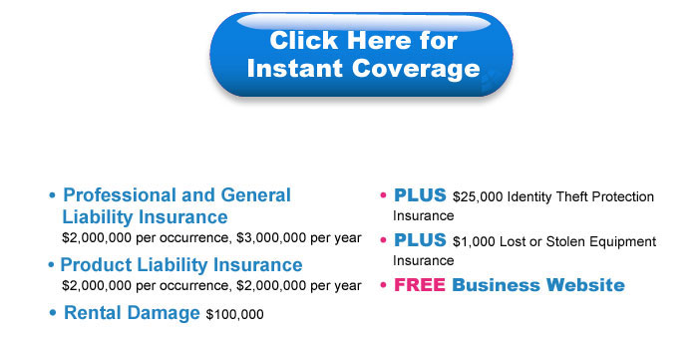
Tools of the Trade Professional Liability Insurance
As a massage professional, there are certain items that you simply cannot do without.
It is important to carry liability insurance to protect yourself, your business and your clients. We have partnered with Massage Magazine to offer you discounted pricing on this excellent policy Professional Liability Insurance from an "A" rated provider.
LMT Success Group Friends & Colleagues
Receive $10 Off Liability Insurance!
$159 $149.00 per year Student Rate: $77.00 per year

Slide 25
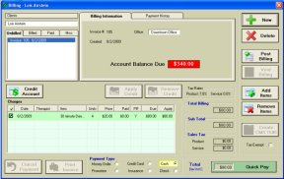
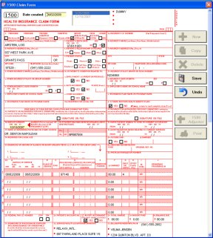
Tools of the Trade Office Management Software
If you are running a medical massage practice, you will surely want to invest in an office management software system.
We recommend Island Software Massage Office Professional Version 2. We have been using this software system at our offices for years and find it to be the best, most complete, easy to use system around.
This program will make running your business easier, faster and more efficient. It includes everything you need to keep track of your clients, schedule appointments, maintain a SOAP note system, bill insurance, track payments, control inventory and more.

Slide 26
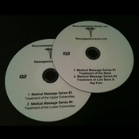
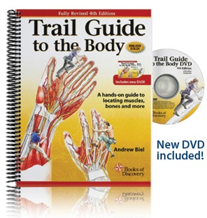
Tools of the Trade DVD’s and Books
The best way to solidify what you have learned in your Medical Massage Practitioner Certification classes is to practice it. Sometimes it is hard to remember every detail, so we are pleased to offer a DVD Review of the Medical Massage Practitioner Certification course. This includes the Day of the Back and Day of the Neck Series and the Upper Extremity and Lower Extremity Series.
The presenter is one of our most popular instructors, Shamaya Chah, who skillfully leads you through step-by-step protocols reviewing what you have learned in the respective classes.
Trail Guide to the Body by Andrew Beil. We love this book and recommend it as a study aid. This is a must have for your massage practice.

Slide 27
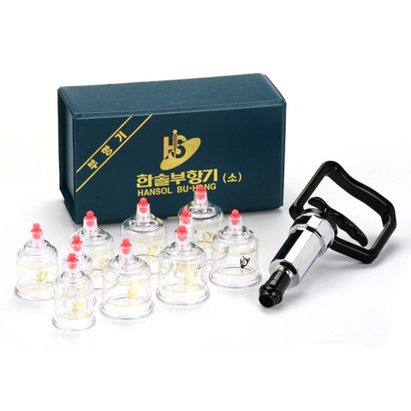
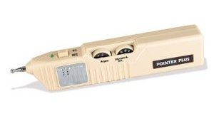
Tools of the Trade Modalities
Massage Cups are such a useful item to have on hand to help to alleviate your client’s pain. The suction of the cups allows you to work at a very deep level and address issues that you might otherwise not be able to. Of course, we recommend first taking the Massage Cupping class or other such training to be sure that you are proficient in their use.
The Pointer Plus E-Stim Device is another great tool to have at your disposal. It is an easy to use trigger point locator that incorporates a push button stimulation feature to immediately treat the affected area. It is as simple to use as pressing the button on the top of the device to the stimulation mode for immediate point location and treatment.

Slide 28
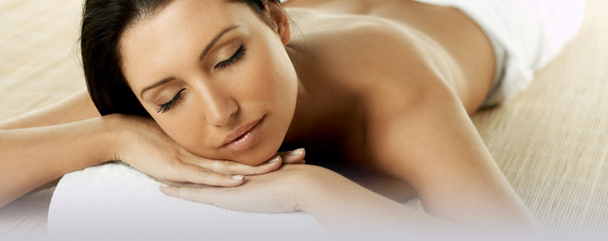
Thanks for your interest in our seminars.
www.lmtsuccessgroup.com
We have helped tens of thousands of therapists build successful careers in massage therapy and we can help you too.
We’ll see you in class!
If you have any questions, feel free to give us a call at #800-201-2247.

